Slide 1
Project Management
Dwight Fischer, CIO
Plymouth State University
Plymouth, New Hampshire

Slide 2
Agenda
Elements of Successful (and Unsuccessful) Projects in Higher Education
Tools of the Trade
  Project Charter
  Work Breakdown Structure
  Project Schedule
  Project Budget
Managing the Project
Project Manager’s Role
Managing Change
Navigating the Politics of Change
Resources for the Project Manager
Notes:
Explain distinction in higher ed
Address their needs and questions, make it dynamic
Ground Rules
Cells to vibrate or off
Interactive to a point

Slide 3
Presenter
CIO at Plymouth State University
Led major projects on three campuses of the University System of New Hampshire
Instructor for University of Phoenix online course in Project Management
Masters Degrees in Counseling and Executive MBA
Notes:
Add note about why you got to PM
Distributed management team at KSC. Always banging heads
PM becoming more and more critical in IT and Construction
Accountability
Cost
time to completion
I like the blend of management, organization, technology and politics
AND, the ability to get things done
Two ERP implementations
Library & IT Integration
Campus Scheduling
And I am trying this out on you all, which is risky, because if I lay out any bullshit, you know better

Slide 4
Why Project Management?
Today’s complex environments require ongoing implementations
Project management is a method and mindset…a disciplined approach to managing chaos
Project management provides a framework for working amidst persistent change
Notes:
Business applications in an academic setting

Slide 5
Themes Requested
Alignment of projects to organizational mission, goals and objectives
Resource conflicts; being spread too thin
Organization: traditional vs a matrix, and how to get things done when you are not in control
PM role; Supervisor of many, but manager of none.
Managing smaller projects and keeping track of them
Being organized when organization is not your greatest strength

Slide 6
Themes Requested
Establishment of PM Office?
Projects that initiate new work & responsibilities
Developing effective work teams with individuals who dislike one another
Getting realistic timeframes attached to project initiatives
Controlling changes to development

Slide 7
Themes Requested
How do we apply PM in higher education, a culture not known for application of business-like methods
Improved change management practices
Getting vendors to follow up on their end of the deal
Ideas around moving an operation to a new facility

Slide 8
Themes Requested
Project management as applied to an academic library setting

Slide 9
Project Management: Official Definition
A project is a temporary endeavor undertaken to create a unique product or service. It implies
  a specific timeframe
  a budget
  unique specifications
  working across organizational boundaries

Slide 10
Project Management: Unofficial Definition
Project management is about organization
Project management is about
decision making
Project management is about
changing people’s behavior
Project management is about
creating an environment conducive to
getting critical projects done!

Slide 11
Why Projects Fail
Failure to align project with organizational objectives
Poor scope
Unrealistic expectations
Lack of executive sponsorship
Lack of project management
Inability to move beyond individual and personality conflicts
Politics
Notes:
Pole the audience for examples
Big Dig
Project Fresh
What constitutes at successful project?
NOTE: I have removed all references to the word ‘business’ That seems a negative connotation to many, particularly in academic circles.
EXAMPLE of POOR SCOPE: Let’s put in a new card reader system

Slide 12
Why Projects Succeed!
Project Sponsorship at executive level
Good project charter
Strong project management
The right mix of team players
Good decision making structure
Good communication
Team members are working toward common goals
Notes:
Good Charter includes good scope!
Put people in charge who have skills in leading and managing projects.

Slide 13
Why this matters to YOU
Most of us get to where we are by some technical or specific set of skills
If you want to get things done, you need a good blend of
  Business knowledge
  People management
  Knowledge of organizational politics
  AND an area of technical expertise
  Those are the people that make things happen!
Notes:
Where do you want your career to go?
Do you want to be more effective in your current role?
How are you going to ensure that when you’re in the latter stages of your career, you are not going to be ‘enticed’ to leave before you’re ready
MOST of us get thrust into management roles without any formal training on how to manage these things. PM is a good focus of training.

Slide 14
Laws of Project Management
No major project is ever installed on time, within budget, or with the same staff that started it. Yours will not be the first.
Projects progress quickly until they become 90% complete, then they remain at 90% complete forever.
When things are going well, something will go wrong.
When things just cannot get any worse, they will.
Project Planning and Implementation.
by Abraham Shtub, Jonathan F. Bard, and Shlomo Globerson Copyright © 1994 by Prentice-Hall, Inc.

Slide 15
Laws of Project Management
When things appear to be going better, you have overlooked something.
No system is ever completely debugged. Attempts to debug a system inevitably introduce new bugs that are even harder to find.
A carelessly planned project will take three times longer to complete than expected
A carefully planned project will take only twice as long.
Project teams detest progress reporting because it vividly manifests their lack of progress.
Project Planning and Implementation.
by Abraham Shtub, Jonathan F. Bard, and Shlomo Globerson Copyright © 1994 by Prentice-Hall, Inc.

Slide 16
Core Project Management Tools
Project Charter
Work Breakdown Structure (WBS)
Project Schedule
Project Budget

Slide 17
Project Charter
What must be done?
  What are the required resources?
  What are the constraints?
  What are the short and long term implications?
Why do it?
When must it be done?
Where must it be done?
Who does what?
  Who is behind the project?
  Who is funding the project?
  Who is performing the work of the project?

Slide 18
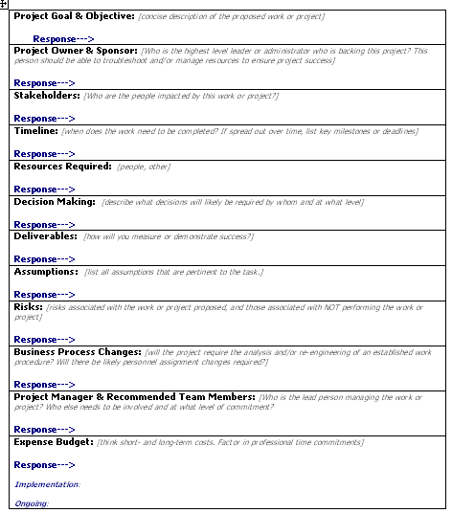
Project Charter
Handout
Who
What
Where
Why
When

Slide 19
Project Charter
Handout
Project Goal & Objective
Sponsor
Stakeholders
Timeline
Resources required
Deliverables
Decision making
Assumptions
Risks
Business process changes
Project manager
Project team
Budget
Signatures
Notes:
Examples for Handouts
What is the RISK of NOT doing the project?
Your target audience for the charter is the LAY EXECUTUVE. If you can write it such that there is no ambiguity there, you are most of the way there.

Slide 20
Assumptions
Opportunity to put it all out there
  Challenges facing the project
  Implications
  Organizational history
  Political implications
  Impact to traditional power
  Requirements of decision-making
Write down what cannot be said
  Keep it objective
Notes:
Share assumptions in Data Center move
in Library move
In ERP implementation

Slide 21
Case Study
Handout
Mojo College
Notes:
Case Study: MoJo College, a small, private, liberal arts school with an enrollment of 2000, has determined that they want to replace their homegrown student, HR and financial information system. They survived Y2K by the heroic efforts of their IT team, the veteran staff who wrote the system 25 years ago. However, administrators listened to their new CIO as she explained the growing risk to the school by their ultimate reliance on a programming staff that was nearing retirement. Additionally, enrollment has been in a steady decline for the past decade. College administrators are attuned to the competition, many of which have instituted new enterprise resource planning (ERP) systems. They wanted a new system that would allow them to perform better projections of student recruitment and retention.
The CIO prepared a project proposal. Trained in project management methodology, she completed a project charter delineated the major components of the project. Among her assumptions, she stated that in order to be successful her IT staff will need to be complemented by a team of IT contractors to not only implement the new system, but help the current staff maintain the existing system. She later presented a budget to administrators for more than $5 million, two thirds ($2 million) of which was contract support.
The executive team of MoJo College reviewed the project plan. They agreed with the goals, objectives, project team and the schedule. The only area where they balked was the budget. The CFO was concerned that the new CIO was being overly cautious by bringing in so much contract help. Furthermore, he was worried that the school’s endowment could not afford $5 million. The last few years saw endowment fund income drop dramatically due to the stock market fluctuations. He proposed that the project budget scale back the contract help in half, to $1 million. His assumption was that the current IT staff could shoulder the load for a few years.
The CIO was taken aback. She was confident that she had presented realistic budget projections. She had worked with counterparts at other schools, the vendor and her staff. She had a strong understanding of the realistic workload of such an endeavor based on her experience in a previous job. A warning signal was going off in her head! However, the experienced professional that she was, she absorbed the feedback, asked for any other suggestions and then asked for some additional time to review them in total and return to the administrative team in a week.

Slide 22
Work Breakdown Structure
Identify the major task categories
Identify sub-tasks, and sub-sub-tasks
Use verb-noun to imply action to something
  Example: Getting up in the morning
    Hit snooze button
    Hit snooze button again
    Get outa bed
    Avoid dog
    Go to bathroom…

Slide 23
Work Breakdown Structure
Canoe Trip to
Boundary Waters
Arrange Travel
Get Equipment
Plan Meals
Prepare Budget
Plan for
Emergencies
Plan Activities
Schedule Flights to Mpls
Contact BW Outfitter
Bring cooking gear
Assign Budget Person
Obtain
emerg. #’s
Bring Cards
Rent Van
Rent canoes
Freeze dry food
Get deposits
Arrange
contact at BW
Bring
Joke book
Arrange Motel
Rent Tents
Prepare 7
breakfasts
Retain Receipts
Bring
emerg. flares
Bring scotch
Schedule return flights
Bring
Sleeping Bags
Prepare 7 lunches
Pay for supplies
Bring two
first aid kits
Bring
Fishing Gear
Prepare 6 dinners
Close-out trip
Bring lights and
waterproof
matches

Slide 24
Work Breakdown Structure
Canoe Trip to
Boundary Waters
Arrange Travel
Get Equipment
Plan Meals
Prepare Budget
Plan for
Emergencies
Plan Activities
Schedule Flights to Mpls
Contact BW Outfitter
Bring cooking gear
Assign Budget Person
Obtain
emerg. #’s
Bring Cards
Rent Van
Rent canoes
Freeze dry food
Get deposits
Arrange
contact at BW
Bring
Joke book
Arrange Motel
Rent Tents
Prepare 7
breakfasts
Retain Receipts
Bring
emerg. flares
Bring scotch
Schedule return flights
Bring
Sleeping Bags
Prepare 7 lunches
Pay for supplies
Bring two
first aid kits
Bring
Fishing Gear
Prepare 6 dinners
Close-out trip
Bring lights and
waterproof
matches

Slide 25
Work Breakdown Structure
Canoe Trip to
Boundary Waters
Arrange Travel
Get Equipment
Plan Meals
Prepare Budget
Plan for
Emergencies
Plan Activities
Schedule Flights to Mpls
Contact BW Outfitter
Bring cooking gear
Assign Budget Person
Obtain
emerg. #’s
Bring Cards
Rent Van
Rent canoes
Freeze dry food
Get deposits
Arrange
contact at BW
Bring
Joke book
Arrange Motel
Rent Tents
Prepare 7
breakfasts
Retain Receipts
Bring
emerg. flares
Bring scotch
Schedule return flights
Bring
Sleeping Bags
Prepare 7 lunches
Pay for supplies
Bring two
first aid kits
Bring
Fishing Gear
Prepare 6 dinners
Close-out trip
Bring lights and
waterproof
matches

Slide 26
Work Breakdown Structure
Canoe Trip to
Boundary Waters
Arrange Travel
Get Equipment
Plan Meals
Prepare Budget
Plan for
Emergencies
Plan Activities
Schedule Flights to Mpls
Contact BW Outfitter
Bring cooking gear
Assign Budget Person
Obtain
emerg. #’s
Bring Cards
Rent Van
Rent canoes
Freeze dry food
Get deposits
Arrange
contact at BW
Bring
Joke book
Arrange Motel
Rent Tents
Prepare 7
breakfasts
Retain Receipts
Bring
emerg. flares
Bring scotch
Schedule return flights
Bring
Sleeping Bags
Prepare 7 lunches
Pay for supplies
Bring two
first aid kits
Bring
Fishing Gear
Prepare 6 dinners
Close-out trip
Bring lights and
waterproof
matches

Slide 27
Work Breakdown Structure
Handout
System Hardware Replacement
RFP Development
Vendor Selection
Staff Training
Hardware Implementation
Needs Assessment
Research Vendors
Identify training Plan
Schedule Installation
Needs Analysis
Research Sites
Schedule Training
Prepare Site
Write RFP
Select Vendors to mail RFP
Train
Arrange Vendor Support
Finalize with Purchasing
Review Proposals
Configure System
Rank Proposals
Install System
Recommendation

Slide 28
Work Breakdown Structure
Handout
System Hardware Replacement
RFP Development
Vendor Selection
Staff Training
Hardware Implementation
Assess Needs
Research Vendors
Identify training Plan
Schedule Installation
Analyze Needs
Research Sites
Schedule Training
Prepare Site
Write RFP
Select Vendors to mail RFP
Train Sysadmins
Arrange Vendor Support
Finalize with Purchasing
Review Proposals
Configure System
Rank Proposals
Install System
Make Recommendations

Slide 29
Work Breakdown Structure
Requires structured brainstorming

Slide 30
Project Schedule Tools
Many tools available
  Microsoft Project
  Many more specialized software
  www.dotproject.net
  Excel
Most important
  Monitor tasks
  Gantt views of project
    one page views for executives
    rollout and more complex views for work teams
  Critical Paths
  Inputs from multiple teams that roll up to project manager
  Dependencies
  Resources assigned to tasks

Slide 31
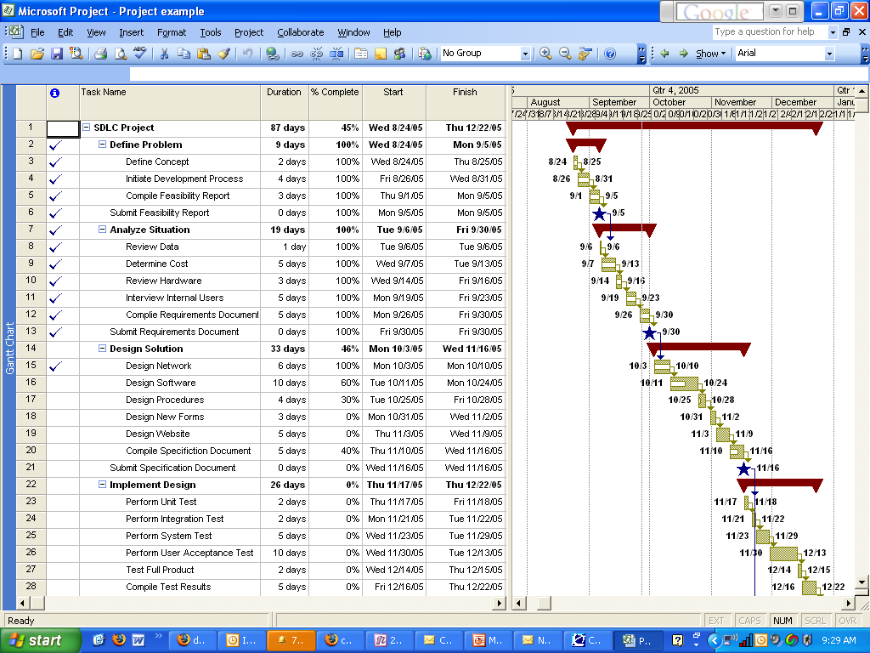
Project Schedule
Handout

Slide 32
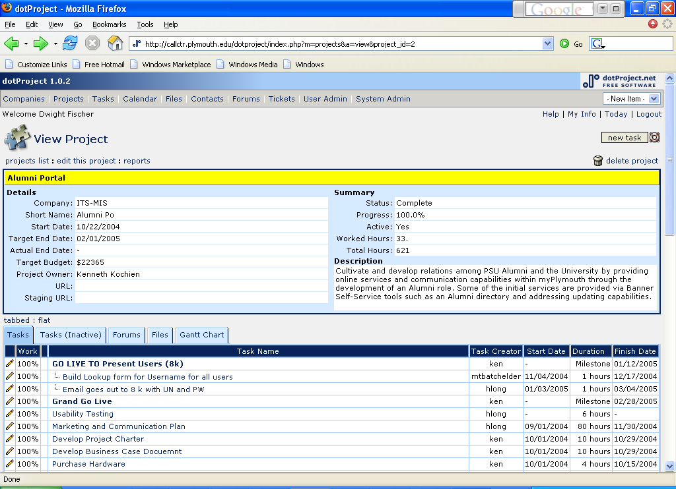
Project Schedule
Handout

Slide 33
Critical Paths
Milestones that impact downstream milestones and the overall timeline of project
If you miss a Critical Path, the entire project is delayed, or
You have to make up ground on downstream critical paths
Notes:
Examples
Bridge construction: CP is the acquisition of a crane
New software implementation: CP is acquisition of new hardware

Slide 34
Project Budget
Direct Costs
Indirect Costs
Ongoing costs
Notes:
One of the more challenging aspects of PM
If you are not a finance person, there are several things you can do.
Find someone to be on your team, or play a role, of budget person
Think about taking some courses in budgeting
Get close to CIO and CFO
If you can gain practice and expertise in budget forecasting, already your star will rise in higher ed…because so few people do!
Many of you who came up through technical ranks tend to shrug this off. This is the work of others. You break out in hives at the mere thought of finance and budget.
Talk about your turnaround experience in MBA

Slide 35
Project Budget
Year 1
Year 2
Year 3
Direct Costs
  Hardware
  Software
  Contractor fees
    Estimated hours
    Hourly Rates per contractor
    Various contractor rates
  Training
  Fanfare
  Other
  TOTALS
Indirect Costs
  Your people’s time and effort
    Estimated time on project
    Estimated cost based on hourly rate
  Other’s time and effort
  Opportunity cost
    What projects or tasks are NOT going to get done in order to get this project done?
Notes:
This is just a dip of the toe in the water. Budget forecasting could easily be a day-long session.
Important points
Spend time here, get as much information as possible
Don’t skimp, but don’t inflate…build in some cushion and work with your Finance People.
Get the CFO engaged.

Slide 36
Managing the Project
Triple Constraint
Five Stages
Project Manager Role
Decision Making Structure
Communication Plan
Meeting Management
Team Development
Navigating Organizational Politics

Slide 37
Triple Constraint
Scope/quality
Resources
Risk?
Time
Notes:
Identify all your constraints
Develop these in the charter
Add a fourth constraint…RISK…use example of Y2k
ARE some constraints more important than others
Y2K
Federal regulation
Upgrades
limited resources, but significant goals…Mojo College
Legal requirement

Slide 38
Five Stages of Project Management
Project Management (in our industry) is divided into five parts:
Project charter development
RFP Development and Process
Planning & Design
  Project team creation
  Project kick-off
  Planning (WBS, schedule)
  Budget
Implementation/construction
Project termination, hand-off to operations mgt.

Slide 39
Controlling Change Procedures
Your Needs Assessment is your baseline document
Establish process early for managing change orders
Original scoping should be thorough as possible
Any subsequent changes must be thoroughly vetted, a form should be completed and members and executives must sign off

Slide 40
Managing Change
Notes:
This is the fun stuff, the soft stuff.
Like finance, many techies would rather this just go away. Imagine, spending time in retreats discussing personal styles, communication, touchy-feely stuff. We’ve got REAL work to do!

Slide 41




Project Manager’s Role
Lead
Communicate
Define
Plan
Monitor
Complete
Communicate
Re-Plan
Notes:
Read and use the A

Slide 42


Project Manager’s Role
Leadership
Organization
Communication
Finance
Technical savvy
Politicking
Team building
Praising
Punishing
Notes:
Who could possibly do all this?
Actually, this IS an impossible role! But the PM doesn’t need to do it all…s/he needs to see that it gets done!
Surround yourself with those people with these skills

Slide 43
Traditional Organization
President
VP Academics
VP Student Affairs
VP Finance
VP Development
Notes:
Hierarchy
Follows rank

Slide 44

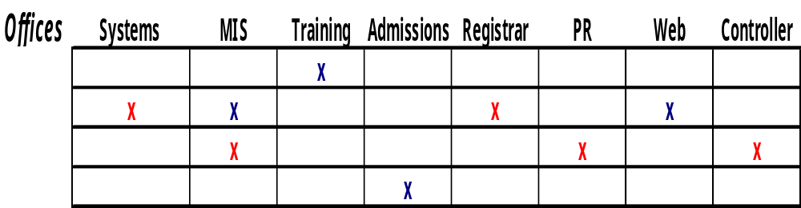
Matrix Organization
Notes:
Requires new sets of skills
UNDER CHARTER AND ARTICULATED GOALS
Persuasion
Politics
Active listening
Focus on goals
Good reporting out to executives
Networking with supervisors
Innovative performance evaluations
Bonuses

Slide 45
People Problems
2/3 of project problems are people related
You will find many operational leaders demonstrate a “just do-it” mentality. While that may be effective in some environments, this is NOT effective in managing change.
There will always be conflict over goals and scope, resources and between departments
You are likely to find a lack of understanding basic project management methods
Some people will never get along
Notes:
Don’t be scared by these findings. Understand them. There are methods you can employ to reduce their occurrence. Let’s move on to the project team and how change may play out there.

Slide 46
So you want to be a Project Manager
You used to be good friends with your co-workers
Project manager sandwich: pressure between co-workers and stakeholders
The skills that brought you to this role are no longer as vital; now you need new skills
You used to be really good at your work
From ESI International:Top Ten Reminders for New Project Managers www.esi-intl.com/public/publications/html/20050801HorizonsArticle2.asp
Notes:
Solutions for the New Project Manager
So what to do, what to do, what to do? Here are a few guidelines for getting started down the right path on your first project management gig.
1. Understand the project scope and stakeholder expectations at the onset of the program.
2. Get yourself a mentor as quickly as possible.
3. Recognize that relationships will change.
4. Manage change rigorously.
5. Know the people, not just the resources.
6. You are what you measure.
7. Talk to stakeholders every day.
8. Talk to staff every day.
9. Lead by example.
10. Have fun.

Slide 47
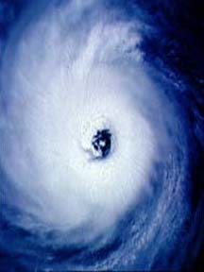
Project Manager’s Key Strength
Be the eye of the hurricane
Notes:
Be calm, avoid reacting to other people’s stress
Take in bad news gracefully, avoid emotional reactions
Take deep breaths every day
Sleep on challenging news
People around you will react to your reactions
Dust in the wind factor

Slide 48
Strategies for Managing Change

Slide 49
Team Development
Select the right players
  Complementary skillsets
  Blend of technical and business
  Align with WBS
Stages of Team Development
  Formin’
  Stormin’
  Normin’
  Performin’
Notes:
http://www.mindavation.com/articles/jan03_intellections.htm
USE OF CONSULTANTS

Slide 50
Formin’ Stormin…in theory
PERFORMIN!’
Normin’
Stormin’
Formin’

Slide 51
Formin’ Stormin…in reality
Performin’
Stormin!’
Formin’
Normin’

Slide 52
Formin’ Stormin…in reality
Formin’
Performin’
Stormin!’
Normin’
Notes:
Some groups can get there quickly, but it may not be sustainable.
DURATION of group is a big factor

Slide 53
Consultants
Objective, skilled consultants can provide a team foundation
Consultants can address dicey organizational issues
For large projects, this approach is vital.
Notes:
Discuss experiences with
Bollerud
KSC, three days with execs & key players for ERP implementation

Slide 54
Meeting Management
Develop Ground Rules early
  Assign facilitator
  Assign reporter and reporting structure
  Start and end times, frequency of meetings
  Frequency of meetings
  Focus of meetings
    Information sharing?
    Agenda building
    Issues for substantive discussion
Notes:
Distinguish between facilitator and leader
Talk about the perpetually latecomer to meetings
the quiet person and the talker

Slide 55
Suggested Ground Rules for Meetings
Start/end times are real
Agree to debate issues, not people
Civility required
Confidentiality?
Reporting out
  What is going to be reported
  What isn’t
Agree to bring all issues to the table

Slide 56
Destructive Team Member Profiles
The Tank: a person who dominates a discussion or issue by brute force of personality. When they present, they speak as an authority. When dealing with a project and defining new solutions, these types of people can be destructive to the process of open discussion and consideration of alternatives.
  Solution: thank them for their opinion, then ask if there are some other perspectives from other team members.

Slide 57
Destructive Team Member Profiles
The Grenade: The conversation will be going along fine and all of the sudden, a team member lobs out a discussion-ending comment.
  Solution: Address the comment head on and suggest that the grenade thrower refrain from comments that will upend conversation of alternatives.

Slide 58
Destructive Team Member Profiles
The Think-they-know-it-all: Much like the tank.
  Solution: Same as Grenade.

Slide 59
Destructive Team Member Profiles
The Maybe Person: This is the person who cannot commit to any position or issue. They take refuge in ambiguity.
  Solution: On a project team, you need to help them commit. Give them simple alternatives and ask them to decide.

Slide 60
Destructive Team Member Profiles
The No Person: This is your general naysayer. Nothing will work, no matter what.
  Solution: Help to see that no is not an option. Define the alternatives.

Slide 61
Destructive Team Member Profiles
The Sniper: This is a destructive force in a team. The Sniper tenders up negative comments within the team that negate or attack ideas.
  Solution: address the behavior immediately and let them know that comments like that are unacceptable based on team norms.

Slide 62
Destructive Team Member Profiles
The Yes Person: While less negative, this person is so agreeable that they negate their influence through a lack of objective analysis. They are more eager to please than they are to offer objective alternatives.
  Solution: Point out that you appreciate their positive outlook, but they need to explore options more thoroughly if they want to gain credibility with the group.

Slide 63
Destructive Team Member Profiles
The Traitor: Team member speaks very little in meetings, or sometimes disagrees, and spends times out of meetings lobbying for alternative positions or arguing decisions made by the team
  Solution: Establish team rules early that state that issues are dealt with in team meetings and this behavior is not acceptable. When it is uncovered, PM addresses it in the meeting or, if necessary, in private

Slide 64
Destructive Team Member Profiles
The End Arounder: Team member who goes around team and PM to another supervisor or administrator and complains, lobbies or takes alternative positions to team.
  Solution: Identify the behavior in team development and make it known it is not acceptable. Get all administrators and supervisors to suppress the behavior if it occurs. PM should call it when it’s seen and the Project Sponsor should nip it in bud.

Slide 65
Providing Feedback to Team Members
Praise in public
Punish in private

Slide 66
Case Study

Slide 67
Decision Making Structure
Define Layers
  Executive
  Project Manager
  Project Team
    Sub Teams
Documentation
Levels of responsibility should be spelled out for each group.
Examples
Execs will make all decisions on scope, schedule, personnel changes and budget
Project Mgt. team will make all decisions on team assignments, work allocations and management of vendors.
Training team will make decisions about training requirements and schedules of sessions.
Notes:
Discuss Approach Document at KSC
3 days of planning
Day 1, VPs included!
Each team should have decision responsibilities articulated.
Example: Exec team responsible for all budget, personnel, scope and schedule changes

Slide 68
Decision Making
Avoid consensus abuse
  Consensus may be desired, but is not required
  Lack of consensus does not mean no decision
  Projects force decisions by leaders
Clarify who makes what decisions
Establish structure for rapid decision making
Communicate decisions
Log/track decisions for future reference
While everyone may not agree with all decisions, it’s important that team members agree to support the decisions
Get buy-in from sponsor and administrators preventing ‘end arounds.’

Slide 69
Communication Plan
Define stakeholders
Develop communication plan
  Identify
    talents for communication
    means of communication
    frequency of communication

Slide 70
Navigating the Politics of Change
Know the environment
  What are the overarching issues of your organization?
  What are the pressing issues of the hour?
  What will be the pressing issues of tomorrow?
  How do you help others satisfy their needs?
  What is the stake of others in your project?
Identify a mentor

Slide 71
Project Management is Change
Project methodology is really about managing change
  Change in current practices
  Developing new practices
  Getting people to change their behaviors
    How they do their work
    How they work together
    How they get the work of the project done
    Avoidance of paving the cowpaths
PM is a mindset, a discipline, that can help your organization increase effectiveness and put order to chaos

Slide 72
Limitations of Project Management
PM works when there is buy-in for the methods and process
It does not work when
  buy-in is lacking or there is not support for the methods by executives
  ‘end arounds’ are tolerated
  influential players operate project business outside the project
  decisions made by project teams are not supported
  charters, schedules and other work products of the team are not supported

Slide 73
Project Portfolio Management
More common in disciplined IT organizations
Manages projects that are
  Proposed
  Approved
  In progress
Requires organizational buy-in
Notes:
Talk about PM offices

Slide 74
Additional Project Resources
ESI Horizons www.esi-horizons.com
Project Management Institute. www.pmi.org
On Becoming a Technical Leader. by Gerald Weinberg
On Becoming a Leader. by Warren Bennis
Getting Past No. by William Ury
Decision Traps. by Edward Russo

